Slide 1
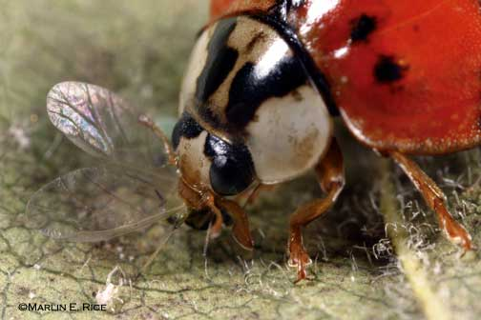
Introduction to Applied Entomology
Natural and Biological Control

Slide 2
Know…
the difference between natural biotic control and biological control.
the "players" (by category) in biological control, what are they used for, and how are they used.
the categories of pathogens that attack insects.
the various forms of Bacillus thuringiensis and the groups of insects that each affects.
the habitat in which Steinerrnema and Heterorhabditis are most likely to be successful (and who they are).
why the Vedalia beetle is famous.
the identity and primary prey or hosts of: lady beetles in general, Cryptolaemus, lacewings, Orius, and Encarsia.

Slide 3
Natural control
Biotic - Accomplished by living organisms
Abiotic - Caused by physical conditions
No human involvement

Slide 4
Biological control
What it isn’t….
Natural control
Judicious use of pesticides
Host plant resistance

Slide 5
Biological control
What it is… “3 sets of 3”
Who? – Predators, Parasites (Parasitoids), Pathogens
To do what? – To reduce, delay, or prevent insect infestations
How? – By conservation, augmentation, or importation of natural enemies

Slide 6
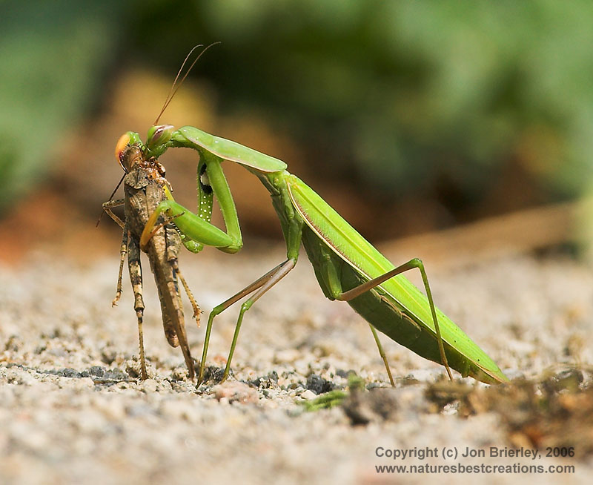
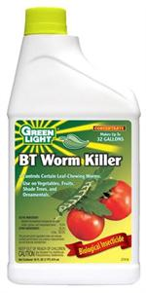
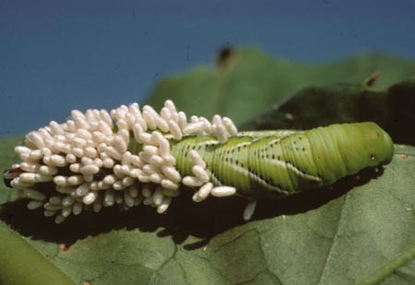
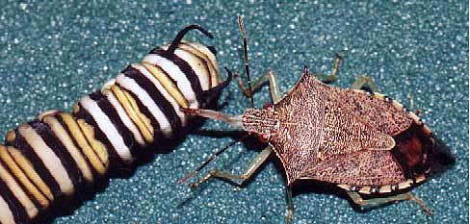
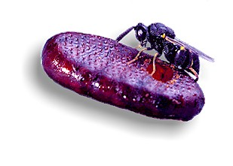
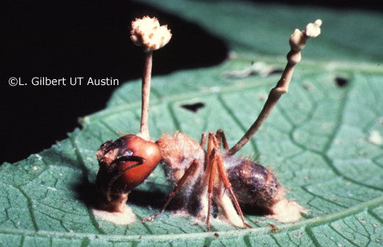
Biological control: Who?
Predators
Parasites (Parasitoids)
Pathogens

Slide 7
Biological control: To do what?
Reduction ... natural enemies are introduced after the pest is established. Examples: Vedalia beetle and cottony cushion scale, predators and parasites of alfalfa weevil, cereal leaf beetle, gypsy moth, countless others.
Delay (pest buildup) ... early intervention after initial detection of a pest.
Prevention ... releases of natural enemies are made early in the season, against a predictable pest; rarely done.

Slide 8
Biological control: How?
Conservation ... nearest to natural control (but conscious and planned); may involve enhancing benefits (using attractants or foods to keep predators and parasites in an area); often involves altered production practices or pesticide application plans.
Augmentation ... adding natural enemies; works if the practice adds to overall mortality instead of replacing existing mortality factors. Involves buying or rearing natural enemies.
Importation ("classical biological control") ... Many pests are exotic; they were introduced without their natural enemies; importing natural enemies "reunites" the pest with its natural control agents. Importation must involve extensive natural history studies and a quarantine stage to avoid unwanted outcomes.

Slide 9
Pathogens:
Bacteria
Viruses
Fungi
Protozoa (microsporidia)
Nematodes

Slide 10
Pathogens:
Many are important in causing population crashes in nature (natural biotic control, not biocontrol), especially...
viruses in Heliothis / Helicoverpa (tobacco budworm and corn earworm), alfalfa looper, tent caterpillars and forest sawflies;
fungi in alfalfa weevil, potato leafhopper, and green cloverworm;
microsporidia in grasshoppers, corn borer, many others (not complete population crashes, just markedly "poor performance")
See handout for more details. Though some have been mass‑produced and packaged, for the most part, these have not been readily formulated as effective "microbial insecticides".

Slide 11
Pathogens: Viruses
Viruses commonly cause disease outbreaks and population crashes in caterpillars. A few virus‑based biopesticides are available commercially, but they are not used widely in the U.S. (Products include viruses that infect codling moth, gypsy moth, corn earworm, tussock moth, and others.)
Check the web site on baculoviruses at: http://www.nysaes.cornell.edu/ent/biocontrol/pathogens/baculoviruses.html

Slide 12
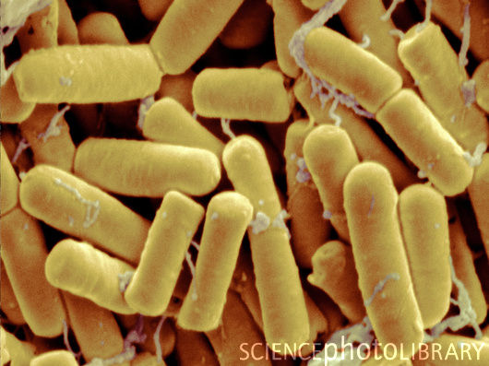
Pathogens: Bacteria
Bacillus thuringiensis: rarely responsible for obvious natural control, but effective as a microbial insecticide ...
  B.t. kurstaki and B.t. aizawai ‑‑ kill caterpillars (Dipel, Agree, XenTari)
  B.t. israelensis ‑‑ kills larvae of several mosquitoes, black flies, fungus gnats (Altosid, Vectobac, Gnatrol)
  B.t. tenebrionis ‑‑ kills larvae of Colorado potato beetle, elm leaf beetle, a few others (M‑One, M‑Trak, Foil)

Slide 13
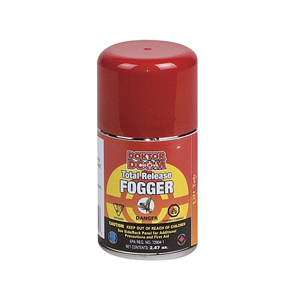
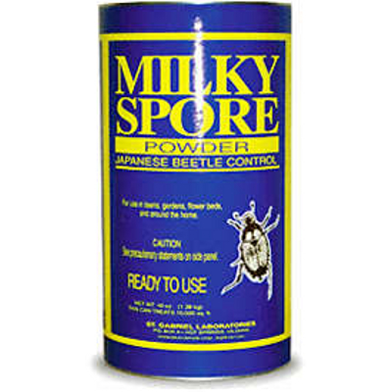
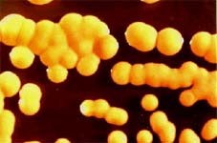
Pathogens: Bacteria
B. sphaericus ‑‑ Larvae of some mosquitoes (no commercial formulations at present)
B. popilliae & B. lentimorbus ‑‑ kill larvae of Japanese beetle, not as effective against other white grubs (Doom, Japidemic)

Slide 14
Pathogens: Insect-pathogenic fungi
Insect‑pathogenic fungi often cause disease outbreaks in insect populations, but few have been commercialized as biopesticides, largely because of…
  difficulty in producing virulent strains that maintain viability "on the shelf“.
  The importance weather conditions and microhabitat factors on the effectiveness of products applied in the field.

Slide 15
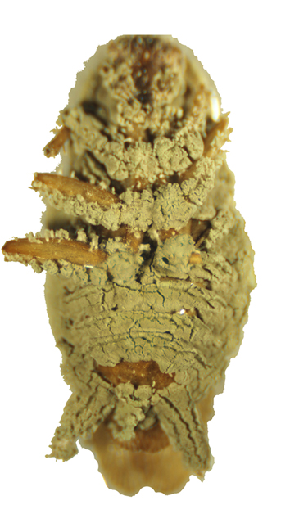
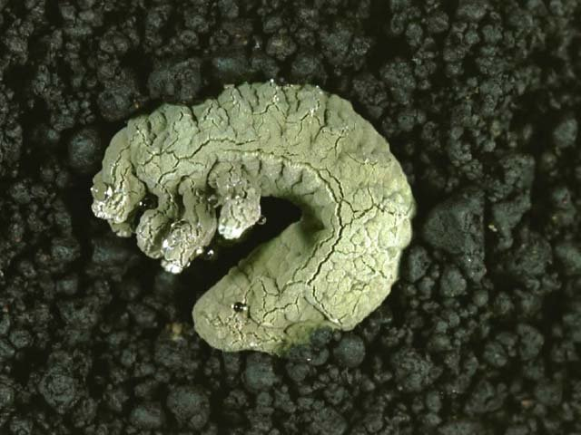
Fungi that kill insects
Metarhizium anisopliae: infects a broad range of hosts, including corn rootworms, white grubs, and root weevils.
A commercial cockroach bait station uses M. anisopliae to kill cockroaches.

Slide 16
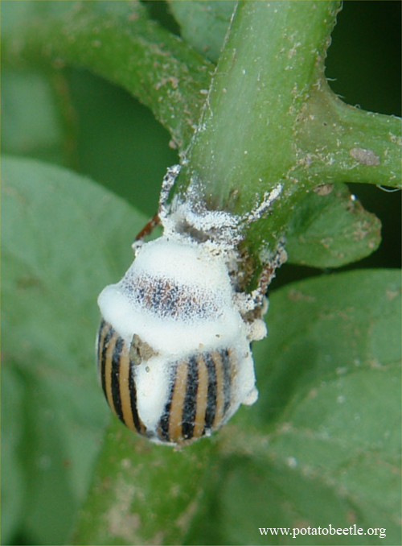
Fungi that kill insects
Beauveria bassiana: (white muscardine fungus) kills a wide range of insects including European corn borer, Colorado potato beetle, and tussock moths.
Mycotrol, a product recently registered for use in the United States, contains B. bassiana; many products are in use in other countries.

Slide 17
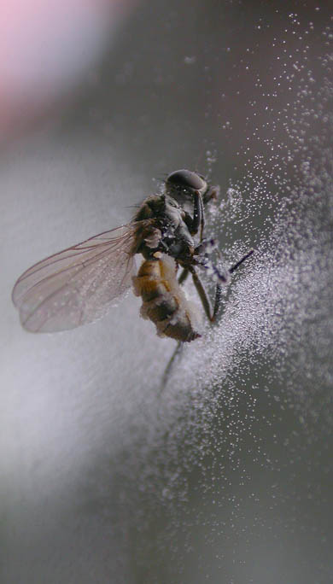
Fungi that kill insects
Entomophthora muscae (and E. grylli and others): E. muscae kills flies ‑‑ house flies, seed and root maggot adults, and others.
The fungus sporulates from the intersegmental membranes of dead and swollen adult flies. House flies may die on a window pane and be surrounded by a ring of spores.

Slide 18
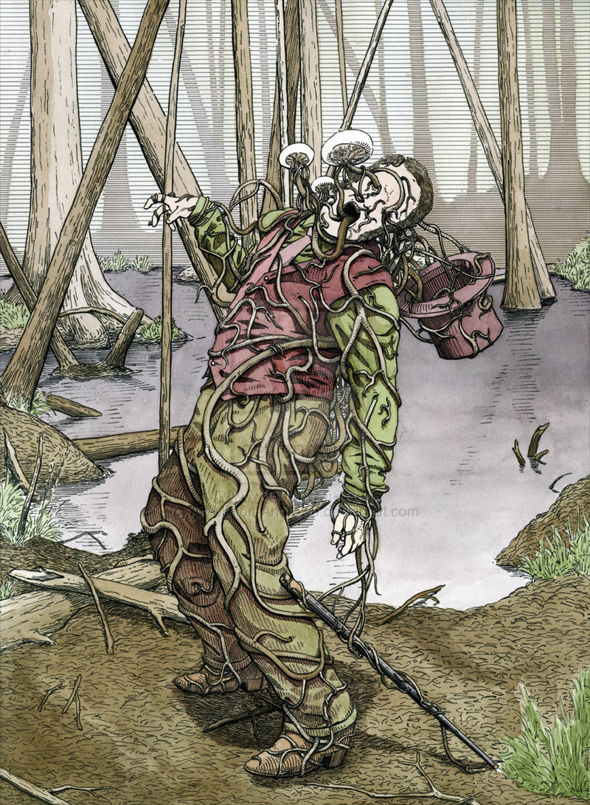
Cordyceps: ZOMBIE FUNGUS
Not biocontrol.
Occurs and kills without human involvement: natural biotic control

Slide 19
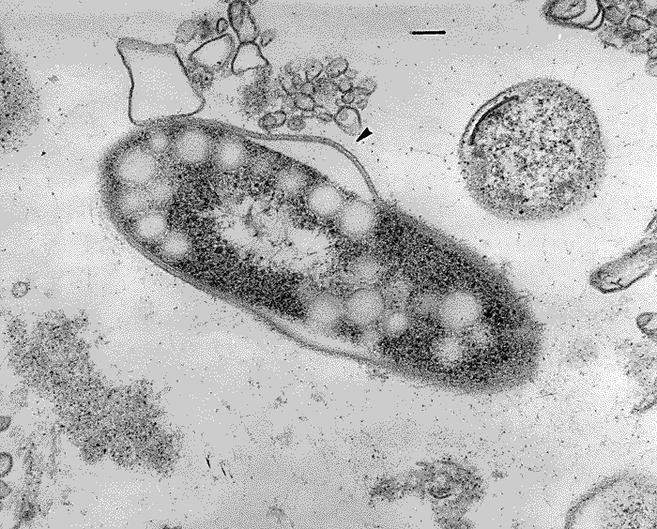
Pathogens: Microsporidia
An important Midwestern example is Nosema pyrausta, a pathogen of the European corn borer.
  Infections usually do not cause rapid death
  Slows development, females lay fewer eggs (many of which die)
N. pyrausta causes periodic collapses in European corn borer populations in Illinois and neighboring states.
Microsporidia have not been commercialized as biopesticides except for Nosema locustae, a species that attacks grasshoppers.

Slide 20
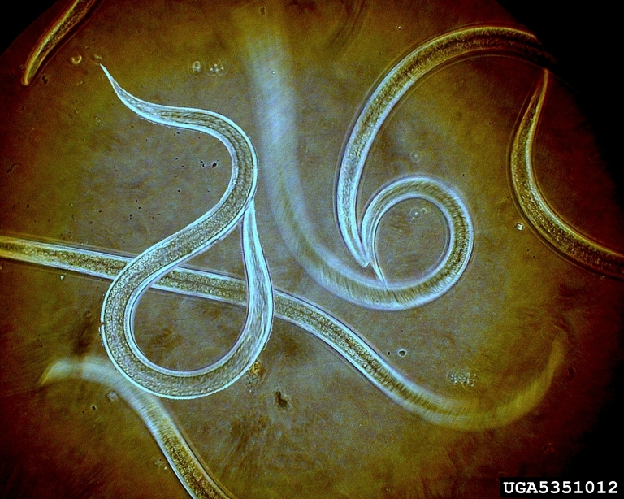
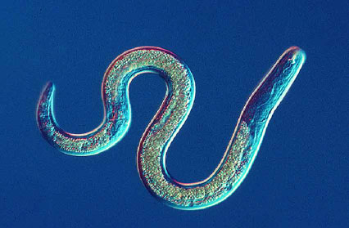
Pathogens: Insect-parasitic nematodes
The nematodes that have been cultured for sale as "biopesticides" include species in the genera Steinernema and Heterorhabditis.
  They enter an insect's body through the mouth, anus, or spiracles, move into the body cavity, and release symbiotic bacteria that multiply within the host insect.
  Infection by these bacteria is what kills the insect host. The nematodes feed on the bacteria, complete their development, and reproduce, yielding thousands of progeny that then seek another host.
Nematodes can be effective against soil insects, particularly in settings where irrigation can be used to maintain soil moisture.
  Root weevil larvae, seed and root maggots, fungus gnat larvae, and others.
  Nematodes have NOT proven to be effective against wireworms, corn rootworms, grape phylloxera, or several other key pests.

Slide 21
Pathogens
Using pathogens as microbial insecticides is a form of augmentation. Conservation and importation are also possible approaches.
Be sure to check the handout to understand why microbial insecticides are considered good from an environmental and human health perspective and to learn their general limitations.
Reference:Weinzierl, R., and T. Henn. 1991. Alternatives in Insect Management: Biological and Biorational Approaches. North Central Regional Extension Publication No. 401. Cooperative Extension Service, University of Illinois at Urbana‑Champaign. (Handouts taken from this)

Slide 22
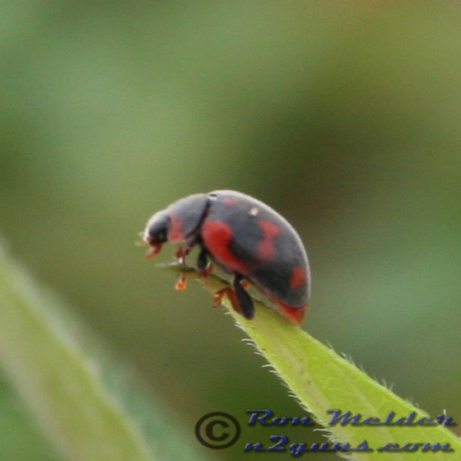
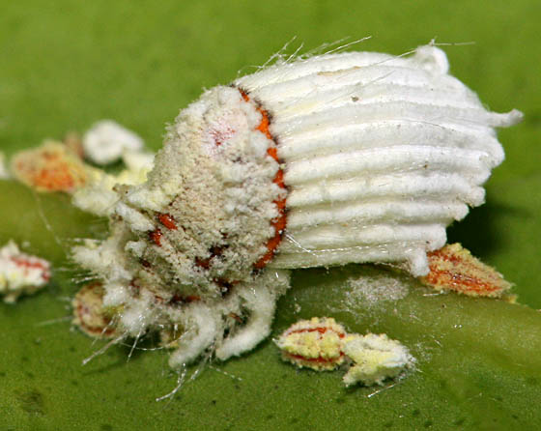
Predators & Parasites: Importation
The classic example of successful importation ... Vedalia beetle for control of cottony cushion scale in citrus
1868 & 1870s: cottony cushion scale was introduced to California from Australia and became a serious pest of citrus and ornamentals.

Slide 23
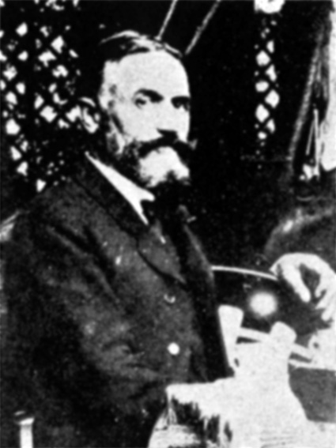
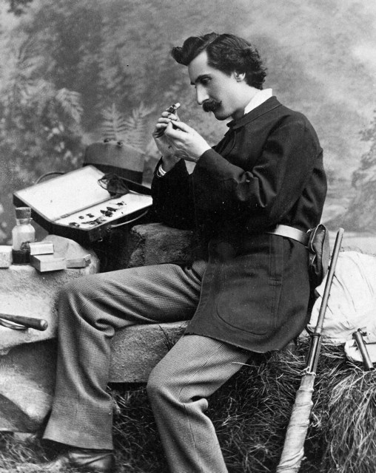
Predators & Parasites: Importation
1887: C.V. Riley convinced the California Fruit Growers' Convention to pressure the U.S Congress to provide $2,000 for the covert collection of natural enemies in Australia.
He sent Albert Koebele to Australia (presumably to represent the California citrus growers at the world agricultural exposition).
Koebele returned with parasites (Cryptochaetum iceryae) and Rodolia cardinalis (the Vedalia beetle!)

Slide 24
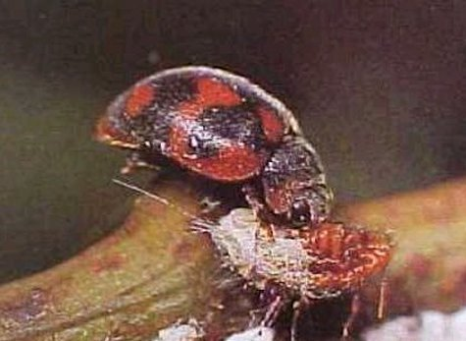
Predators & Parasites: Importation
Result: Fantastic control of cottony cushion scale until DDT was used in orchards in the late 1940s (and still important now).
The Vedalia beetle was extremely easy to establish at new locations.
  For example, only 4 adults were taken to Peru, and successful populations developed! Imported predators are usually more difficult to establish.

Slide 25
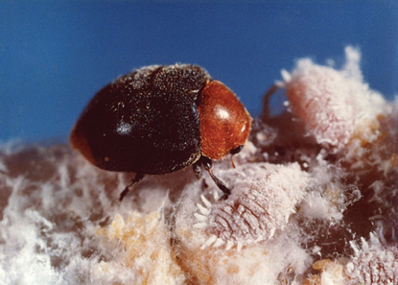
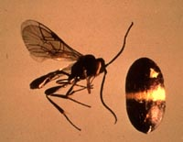
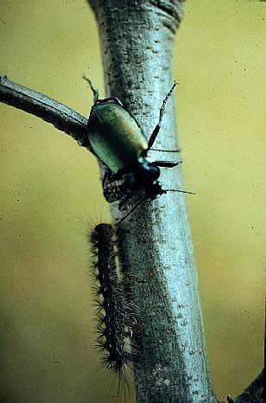
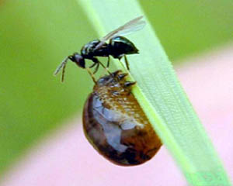
Predators & Parasites: Importation
Other successful introductions (examples):
Cryptolaemus – mealybug destroyer
Larval parasites (Hymenopteran) of cereal leaf beetle
Parasites of the alfalfa weevil
Carabids for gypsy moth suppression
And many more…

Slide 26
Predators & Parasites: Importation
Difficulties with introductions:
Finding a "guild" of natural enemies that together provide adequate control (of not only one but most of the pests in a system.)
Natural enemy survival in pesticide‑treated crops or habitats
Quarantines, production of high numbers for release, fitness, climate, more

Slide 27
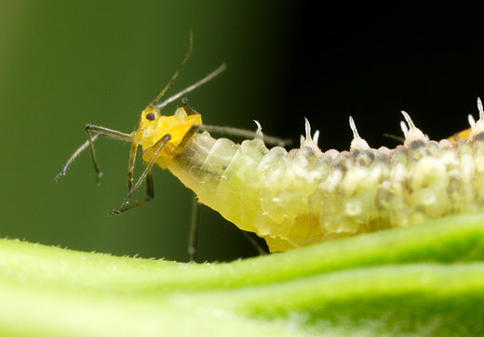
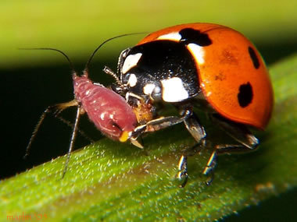
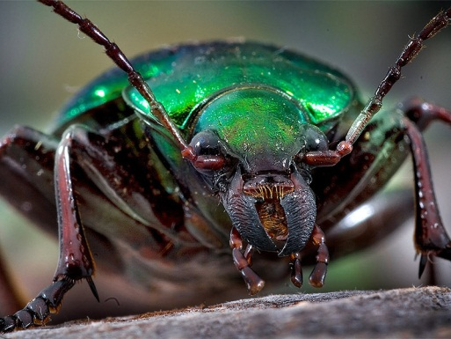
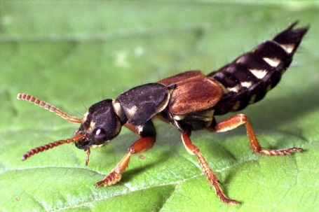
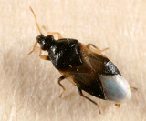
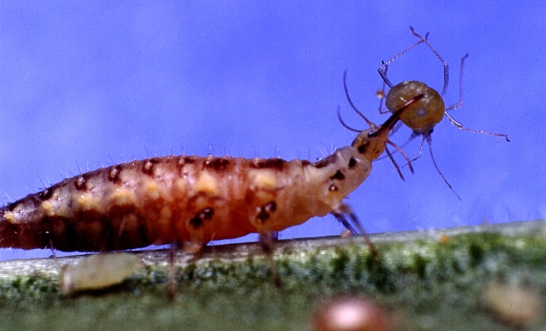
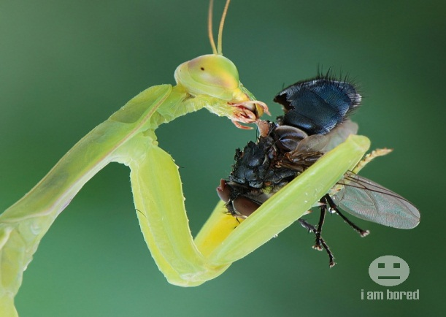
There are many natural enemies "in place" in any region. Read your handout to become familiar with several groups and species, including:
Carabids (ground beetles)
Coccinellids (C‑7, convergent lady beetle, spotted lady beetle, twice‑stabbed lady beetle, Stethorus (mite eater), Asian multicolored lady beetle) ... most eat aphids, but some specialize on scales or mites
Staphylinids (rove beetles)
Syrphid flies (larvae eat aphids)
Lacewings (Larvae are generalists but prefer aphids; adults of the common green lacewing feed only on pollen and nectar.)
Hemipteran predators (Orius [a minute pirate bug], Nabis [a damsel bug],Geocoris [big‑eyed bug], Podisus [spined soldier bug])
Mantids (usually not very beneficial because of prey choice and cannibalism)
Many predaceous mites
(Not all predaceous or parasitic insects are beneficial ... some kill the natural enemies of pests instead of pests.)

Slide 28
More natural predators!
Hornworms vs braconids
Cockroach vs. Emerald Jewel Wasp
- Native to Asia, Africa, and some Pacific islands.
- Unsuccessful introduction to control cockroaches in Hawaii
Parasitoid wasps (and other native predators) are important!!

Slide 29
Predators & Parasites: Conservation
What steps are involved in conservation? (See handout for details)
  Recognizing beneficials
  Minimizing insecticide applications
  Using selective insecticides or treating in selective manner
  Maintaining ground covers, standing crops, and crop residues
  Providing pollen and nectar sources or artificial foods
Be aware ... Cultural practices influence pests and beneficials simultaneously. For example, ground cover plants that provide nectar and pollen for beneficial insects may also attract and serve as a food source for cutworm moths and their larvae.

Slide 30
Predators & Parasites: Augmentation
Natural enemies that are available for purchase and release include:
  Convergent lady beetle (fly away, fly away ...)
  Mealybug destroyer (good in greenhouses)
  Green lacewings (best of general purpose and aphid predators; larvae that hatch on the ground often die)
  Spined soldier bug (fun to watch, feeding rate & pop dynamics don't allow a purchase of these bugs to keep up with pests)
  Praying mantids (ditto but worse; often eat nonpest insects)
  Predaceous mites for spider mite control (some good results in greenhouses, dependent on conditions; possible benefit to re‑inoculating orchards)
  Mites that prey on thrips (good stories from greenhouses, dependent on conditions)
  Encarsia for whitefly control (many successes in greenhouses, often complicated by other pests)
  Parasites of fly pupae (successes in poultry have been difficult to match in other livestock facilities)

Slide 31
An especially useful web site:
Biological Control: A Guide to Natural Enemies in North America, from Cornell University at: http://www.nysaes.cornell.edu/ent/biocontrol/

